Slide 1
UNIT - 4
Front-End Web UI Frameworks and Tools

Slide 2
Introduction to Bootstrap
Bootstrap is a popular front-end framework used for designing responsive and mobile-first websites quickly and efficiently. It includes pre-styled CSS and JavaScript components, such as buttons, forms, grids, and navigation bars, which help developers create professional-looking websites without writing much custom CSS.

Slide 3
What is Bootstrap?
Bootstrap is the most popular HTML, CSS and JavaScript framework for developing a responsive and mobile friendly website.
It is absolutely free to download and use.
It is a front-end framework used for easier and faster web development.
It includes HTML and CSS based design templates for typography, forms, buttons, tables, navigation, modals and many others.
It can also use JavaScript plug-ins.
It facilitates you to create responsive designs.

Slide 4
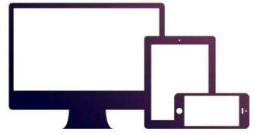
Contd.
Bootstrap is an open-source CSS framework developed by Twitter to make web development easier. It provides:
  A responsive grid system
  Pre-designed UI components
  Powerful JavaScript plugins
  Customizable themes
Bootstrap follows a mobile-first approach, meaning it is designed to work seamlessly on all screen sizes (mobile, tablet, and desktop).

Slide 5
Why Use Bootstrap?
Responsive Design – Automatically adapts to different screen sizes.
Pre-Styled Components – Ready-to-use UI elements (buttons, cards, forms, etc.).
Faster Development – Saves time by using predefined styles and layouts.
Grid System – Uses a flexible 12-column grid for easy layout design.
Cross-Browser Compatibility – Works smoothly on all modern browsers.
Consistent Design – Ensures a professional look across all devices.

Slide 6
What is a responsive website
A website is called responsive website which can automatically adjust itself to look good on all devices, from smart phones to desktops etc.

Slide 7
Bootstrap Versions
Bootstrap 1 (2011)
  Initial release
  Basic grid system
  Simple UI components
Bootstrap 2 (2012)
  Responsive design introduced
  Fluid grid system
Bootstrap 3 (2013)
  Mobile-first approach
  Flat design

Slide 8
Contd.
Bootstrap 4 (2018)
  Flexbox-based grid
  Improved components
  Dropped support for IE9
Bootstrap 5 (2021)
  Removed jQuery dependency
  Improved grid and utilities
  Better CSS customization

Slide 9
Where to Get Bootstrap?
There are two ways to start using Bootstrap on your own web site.
You can:
  Download Bootstrap from getbootstrap.com
  Include Bootstrap from a CDN (Content Delivery Network).

Slide 10
How to Use Bootstrap?
There are two ways to integrate Bootstrap into your project:
Using Bootstrap CDN (Easy & Quick Method)
Just add the following links in your HTML file:
<!-- Bootstrap CSS -->
<link href="https://cdn.jsdelivr.net/npm/bootstrap@5.3.0/dist/css/bootstrap.min.css" rel="stylesheet">

Slide 11
Contd.
<!-- Bootstrap JS (For interactive components) -->
<script src="https://cdn.jsdelivr.net/npm/bootstrap@5.3.0/dist/js/bootstrap.bundle.min.js"></script>
2. Installing via npm (For Developers)
Then import it into your project:
npm install bootstrap
import 'bootstrap/dist/css/bootstrap.min.css';
import 'bootstrap/dist/js/bootstrap.bundle.min.js';

Slide 12
Full-Stack Web Development
Full-stack web development involves designing, developing, and managing both the frontend (client-side) and backend (server-side) of a web application.
The front end consists of the user interface (or UI), and the back end handles the business logic and application workflows that run behind the scenes.
A Full-Stack Web Developer is proficient in multiple technologies required to build an entire web application.

Slide 13
Components of Full-Stack Web Development
Frontend Development (Client-Side)
Backend Development (Server-Side)
Database Management
DevOps & Deployment

Slide 14
Contd.
1. Frontend Development (Client-Side)
This is the part of the application that users interact with directly.
Technologies Used:
HTML – Creates the structure of web pages
CSS – Defines styling and layout (Bootstrap, Tailwind CSS)
JavaScript – Adds interactivity and dynamic content
Frontend Frameworks/Libraries: React.js, Angular, Vue.js

Slide 15
Contd.
2. Backend Development (Server-Side)
The backend is responsible for handling business logic, database operations, and server communication.
Technologies Used:
Programming Languages: Node.js, Python (Django, Flask), Java (Spring Boot), PHP, Ruby on Rails
Backend Frameworks: Express.js, FastAPI
APIs: RESTful APIs, GraphQL for client-server communication

Slide 16
Contd.
3. Database Management
Databases store and manage application data.
Types of Databases:
SQL Databases – MySQL, PostgreSQL
NoSQL Databases – MongoDB, Firebase

Slide 17
Contd.
4. DevOps & Deployment
A full-stack developer should also be familiar with hosting and deploying applications.
Tools Used:
Version Control: Git, GitHub, GitLab
Cloud Hosting Services: AWS, Heroku, Netlify, Vercel
Containerization: Docker, Kubernetes

Slide 18
Popular Stacks
LAMP stack: JavaScript - Linux - Apache - MySQL - PHP
LEMP stack: JavaScript - Linux - Nginx - MySQL - PHP
MEAN stack: JavaScript - MongoDB - Express - AngularJS - Node.js
MERN stack: JavaScript – MongoDB – Express - React.js - Node.js
Django stack: JavaScript - Python - Django - MySQL
Ruby on Rails: JavaScript - Ruby - SQLite - Rails

Slide 19
Version Control System (VCS)
A Version Control System (VCS) is a tool that helps developers manage changes to code over time. It keeps track of modifications, enables collaboration, and allows rollback to previous versions.
Types of Version Control Systems:
Local Version Control (LVC)
Centralized Version Control (CVCS)
Distributed Version Control (DVCS) (Most Popular)

Slide 20
Git
Git is a distributed version control system designed for tracking changes in source code during software development.
Developed by Linus Torvalds in 2005, initially to manage the Linux kernel development.
Used to work collaboratively over a team , track code changes.
Git vs Github
Git: The version control system itself, installed locally on a developer's machine.
GitHub: A web-based platform built around Git, providing a hosting service for Git repositories and additional collaboration features.
Git manages the versioning of code, while GitHub adds features like issue tracking, pull requests, project management tools, and team collaboration.

Slide 21
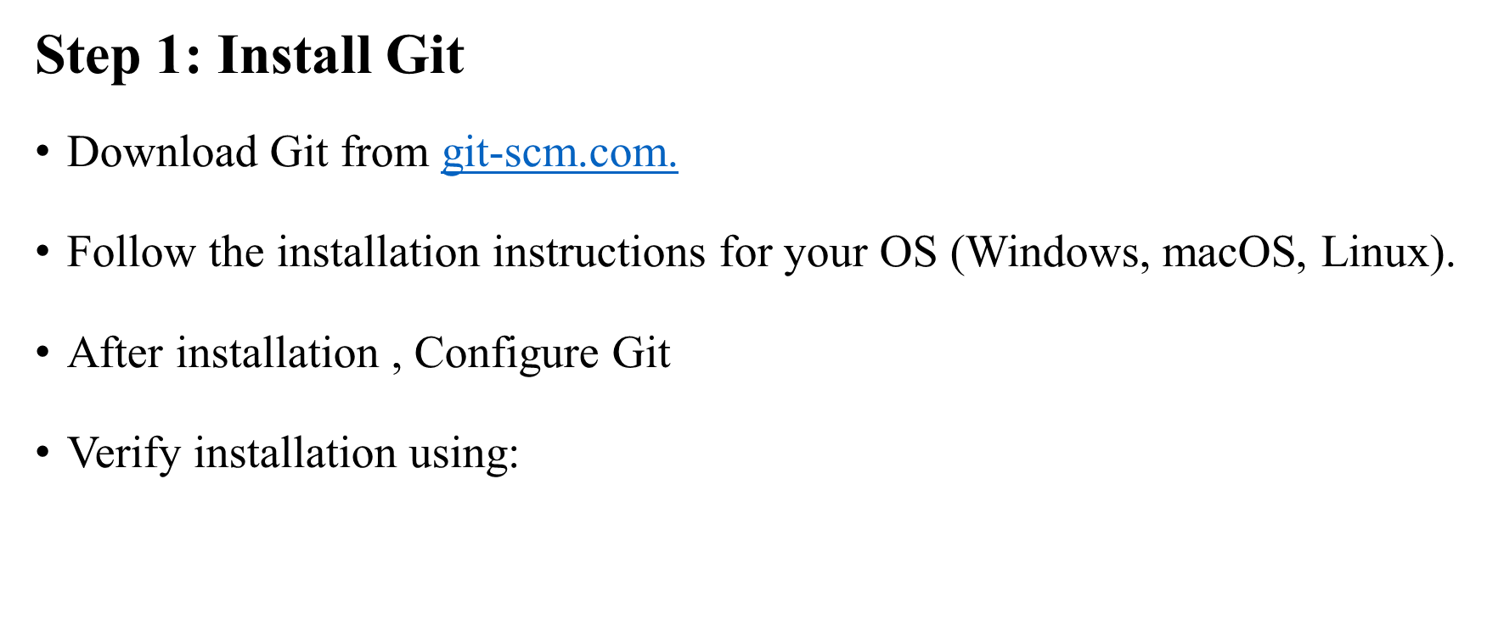
Setting Up Git
git --version

Slide 22
Contd.
Step 2: Configure Git
Before using Git, set up your username and email:
Check your configurations:
git config --global user.name "Your Name"
git config --global user.email "your.email@example.com"
git config --list

Slide 23
Basic Git Commands
git init: - Initializes a new Git repository in the current directory.
git add: - Adds changes in the working directory to the staging area, preparing them for the next commit.
git commit: - Records changes to the repository, creating a snapshot of the staged changes.
git push: - Uploads local repository content to a remote repository, usually hosted on a service like GitHub.
git pull: - Fetches changes from a remote repository and merges them into the local repository.

Slide 24
Contd.
git clone: - Creates a local copy of a remote repository.
git branch: -Lists, creates, or deletes branches within the repository.
git merge: - Combines changes from one branch into another.
git checkout: -Switches branches or restores working tree files to a specific state.
git status: - Displays the current state of the working directory and the staging area

Slide 25
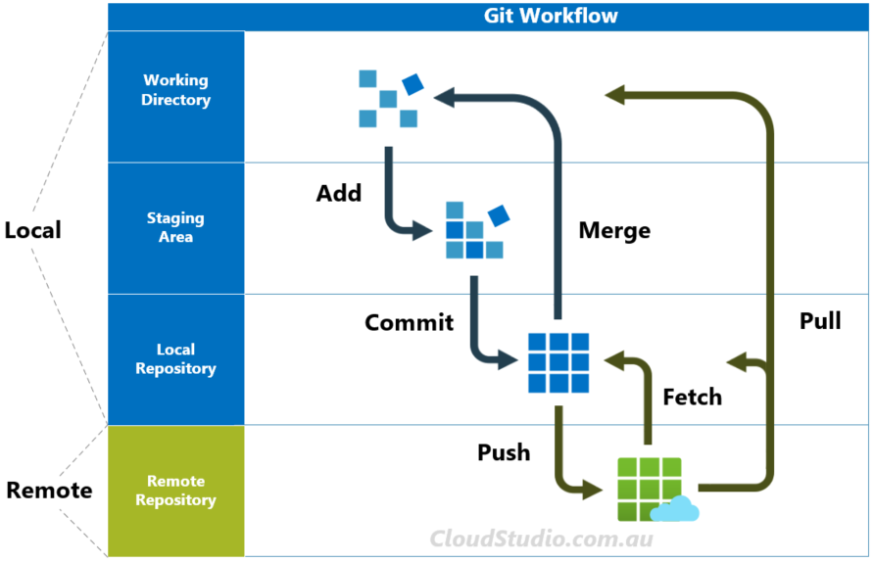
Git Workflow

Slide 26
Contd.
1. Initializing a Repository
This creates a new Git repository in the current directory.
2. Checking Status
Shows the current state of your working directory.
git init
git status

Slide 27
Contd.
3. Adding Files to Staging
4. Committing Changes
Commits staged files with a message.
git add <filename> # Add a specific file
git add . # Add all modified files
git commit -m "Initial commit"

Slide 28
Contd.
5. Check if a remote is set
git remote –v
6. Add a Remote Repository
If you haven't added a remote repository, you need to link your local repository to a GitHub/GitLab repository. Replace <your-repo-url> with your actual repository URL from GitHub:
git remote add origin <your-repo-url>

Slide 29
Contd.
7. Verify the Remote
git remote -v
You should see something like:
origin https://github.com/yourusername/your-repo.git (fetch)
origin https://github.com/yourusername/your-repo.git (push)
8. Push the Code
Now you can push your changes:
git push -u origin main

Slide 30
Contd.
5. Viewing Commit History
6. Creating and Switching Branches
git log
git branch feature-branch # Create a new branch
git switch feature-branch # Switch to the new branch

Slide 31
Contd.
7. Merging Branches
git checkout main # Switch to the main branch
git merge feature-branch # Merge changes from feature-branch into main

Slide 32
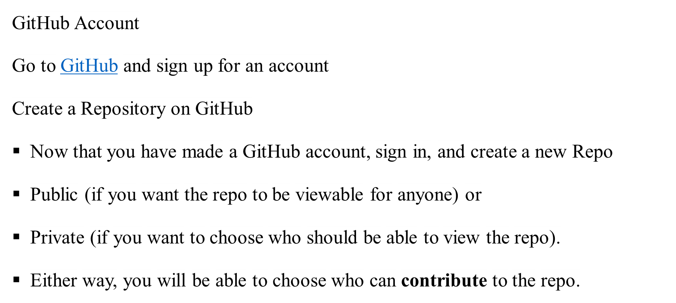
Git Hub

Slide 33
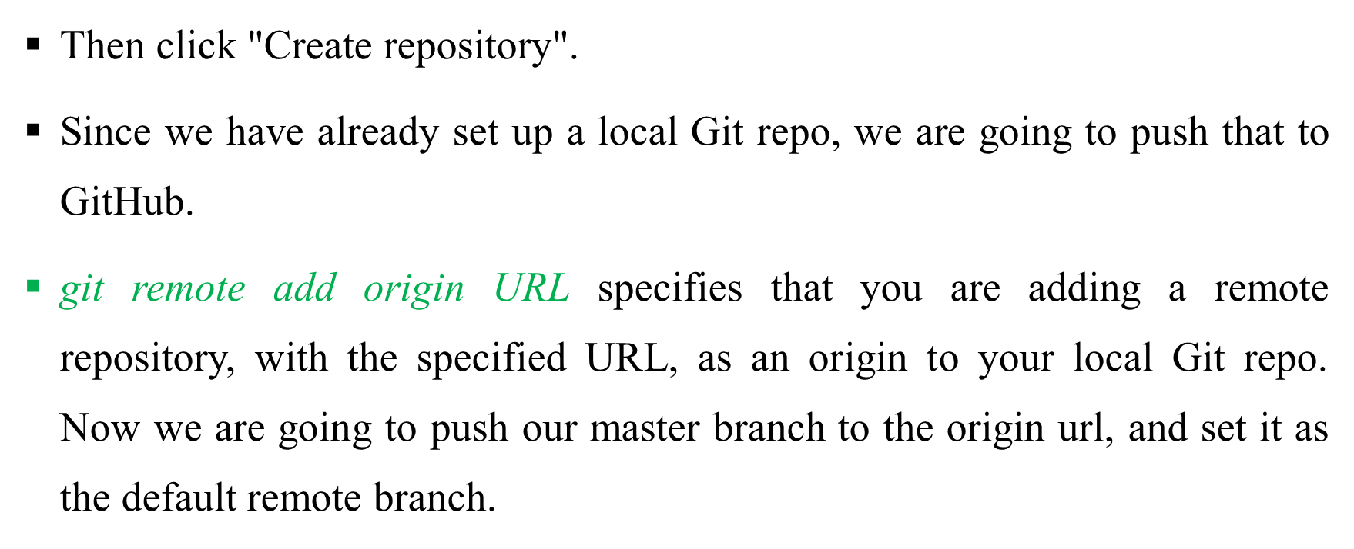
Contd.

Slide 34
Online Git Repositories
GitHub (github.com)
GitLab (gitlab.com)
Bitbucket (bitbucket.org)
SourceForge (sourceforge.net)
AWS CodeCommit (aws.amazon.com/codecommit)
Azure DevOps Repos (azure.microsoft.com)
Google Cloud Source Repositories (cloud.google.com/source-repositories)

Slide 35
Contd.
Creating a GitHub Repository
Go to GitHub and sign in.
Click New Repository.
Give it a name and click Create Repository.
Connecting Local Repo to GitHub
1. Initialize Git (if not done already)
git init

Slide 36
Contd.
2. Add a Remote Repository
3. Push Code to GitHub
4. Cloning a GitHub Repository
git remote add origin https://github.com/your-username/repository-name.git
git push -u origin main
git clone https://github.com/your-username/repository-name.git

Slide 37
Contd.
5. Pulling the Latest Changes
6. Pushing Changes to GitHub
git pull origin main
git push origin main

Slide 38
Difference Between Git and GitHub
Feature | Git | GitHub
Definition | A distributed version control system (DVCS) that tracks code changes. | A cloud-based platform that hosts Git repositories.
Purpose | Manages local and remote code repositories. | Provides a web-based UI for Git, collaboration tools, and hosting.
Hosting | Git itself does not provide hosting—it runs locally on your machine. | GitHub hosts Git repositories on cloud servers.
Collaboration | Git allows local development and push/pull from remote repositories. | GitHub enables team collaboration, pull requests, issue tracking, and CI/CD.
Access | Command-line based (git init, git commit, git push). | Web-based UI with visual tools + CLI support (GitHub Desktop).

Slide 39
Node.js
Node.js is an open source, cross platform runtime environment for server side and networking application.
Basically, Node.js is server side programming language like PHP, C#, Python, Java etc.
Node.js is cross platform. So it runs well on Linux systems, Mac, can also run on Windows systems.
It's an runtime environment used for executing JavaScript code without browser..
We often use node to build back-end services like API's .

Slide 40
Contd.
Node.js is a JavaScript runtime built on the V8 JavaScript engine. It allows you to run JavaScript on the server side, enabling the development and high performance web application. Node.js comes with a package manager called npm (Node Package Manager) that allows you to easily install and manage third-party libraries.

Slide 41
Key Features of Node.js
Asynchronous & Event-Driven – Uses a non-blocking I/O model for better efficiency.
Fast Execution – Runs on the V8 JavaScript engine (same as Chrome).
Single-Threaded but Highly Scalable – Uses an event loop to handle multiple requests efficiently.
Built-in Package Manager (NPM) – Comes with Node Package Manager (NPM) to manage dependencies.
Cross-Platform – Works on Windows, macOS, and Linux.
Used for Full-Stack Development – Works with frameworks like Express.js, Next.js, and Nest.js for backend development.

Slide 42
How Node.js Works (Step-by-Step)
Client Request → A user sends a request (e.g., accessing a website or API).
Event Loop → Instead of creating multiple threads, Node.js handles requests using a single-threaded event loop.
Non-Blocking I/O → If a request requires data from a database or file system, Node.js does not wait for it; it moves to the next request.
Callback Execution → Once data is available, a callback function executes to send the response.
Response Sent → The server sends the response back to the client.

Slide 43
Node.js Installation
Step 1: Download Node.js
Go to the official Node.js website:
https://nodejs.org/
You will see two versions:
LTS (Long-Term Support) – Recommended for most users (stable & reliable).
Current (Latest Features) – Has the newest updates (may be unstable).
    Choose the LTS version for better stability.

Slide 44
Contd.
Step 2: Install Node.js
Step 3: Verify Installation
After installation, open the terminal (or Command Prompt on Windows) and run:
node -v
To check NPM (Node Package Manager):
npm -v

Slide 45
First Node.js Program
After installation, let’s test Node.js by writing a simple program.
1. Create a file named app.js:
console.log("Hello, Node.js!");
2. Run the script in the terminal:
node app.js
Output:
Hello, Node.js!

Slide 46
Why Use Node.js?
Fast & Efficient – Uses Google’s V8 engine for fast execution.
Asynchronous & Non-Blocking – Handles multiple requests without waiting.
Single Language (JavaScript) – Use JS for both frontend & backend.
Scalable – Suitable for high-traffic applications.
Real-Time Apps – Ideal for chat apps, gaming, live streaming.
Cross-Platform – Runs on Windows, macOS, Linux, Cloud.
NPM Ecosystem – Over 1 million packages available.
Works Well with NoSQL (MongoDB) – Uses JSON for easy integration.
Used by Big Companies – Netflix, Uber, PayPal, LinkedIn use Node.js.

Slide 47
Building a Basic Web Server with Node.js:
const http = require('http');
const hostname = 'localhost';
const port = 3001;
const server = http.createServer((req, res) => {
res.statusCode = 200;
res.setHeader('Content-Type', 'text/plain');
res.end('Hello, World!');
});
server.listen(port, hostname, () => {
console.log(Server is running on http://${hostname}:${port}/);
});

Slide 48
NPM (Node Package Manager)
NPM (Node Package Manager) is a tool that helps developers install, manage, and share JavaScript libraries (called packages or modules) for Node.js applications.
It comes automatically installed with Node.js.
It has over 1 million free packages to speed up development.
You can install, update, and remove packages easily.

Slide 49
Why Use NPM?
Feature | Benefit
Package Management | Install and manage third-party libraries easily
Dependency Handling | Keeps track of required modules in package.json
Largest JS Library | Over 1M+ open-source packages available
Speeds Up | Development No need to write everything from scratch
Custom Scripts | Automate tasks using NPM commands

Slide 50
Basic NPM Commands
Command | Description
npm -v | Check installed NPM version
npm init | Create a new package.json file
npm install <package> | Install a package locally
npm install -g <package> | Install a package globally
npm uninstall <package> | Remove a package
npm update <package> | Update a package
npm list | Show installed packages

